Slide 1
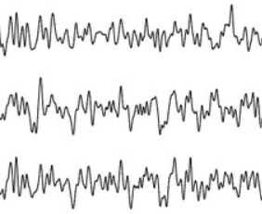
μ
Reconstructed EEG signal (X_{R})
Input EEG signal (X)
vEEGNet Encoder
vEEGNet Decoder
Reparametrization
Z₁ = μ + σ ⋅ N(0,1)
σ
Classifier
Concatenation
Z₂ = [ μ , σ ]
Label (Y_{c})

Slide 2
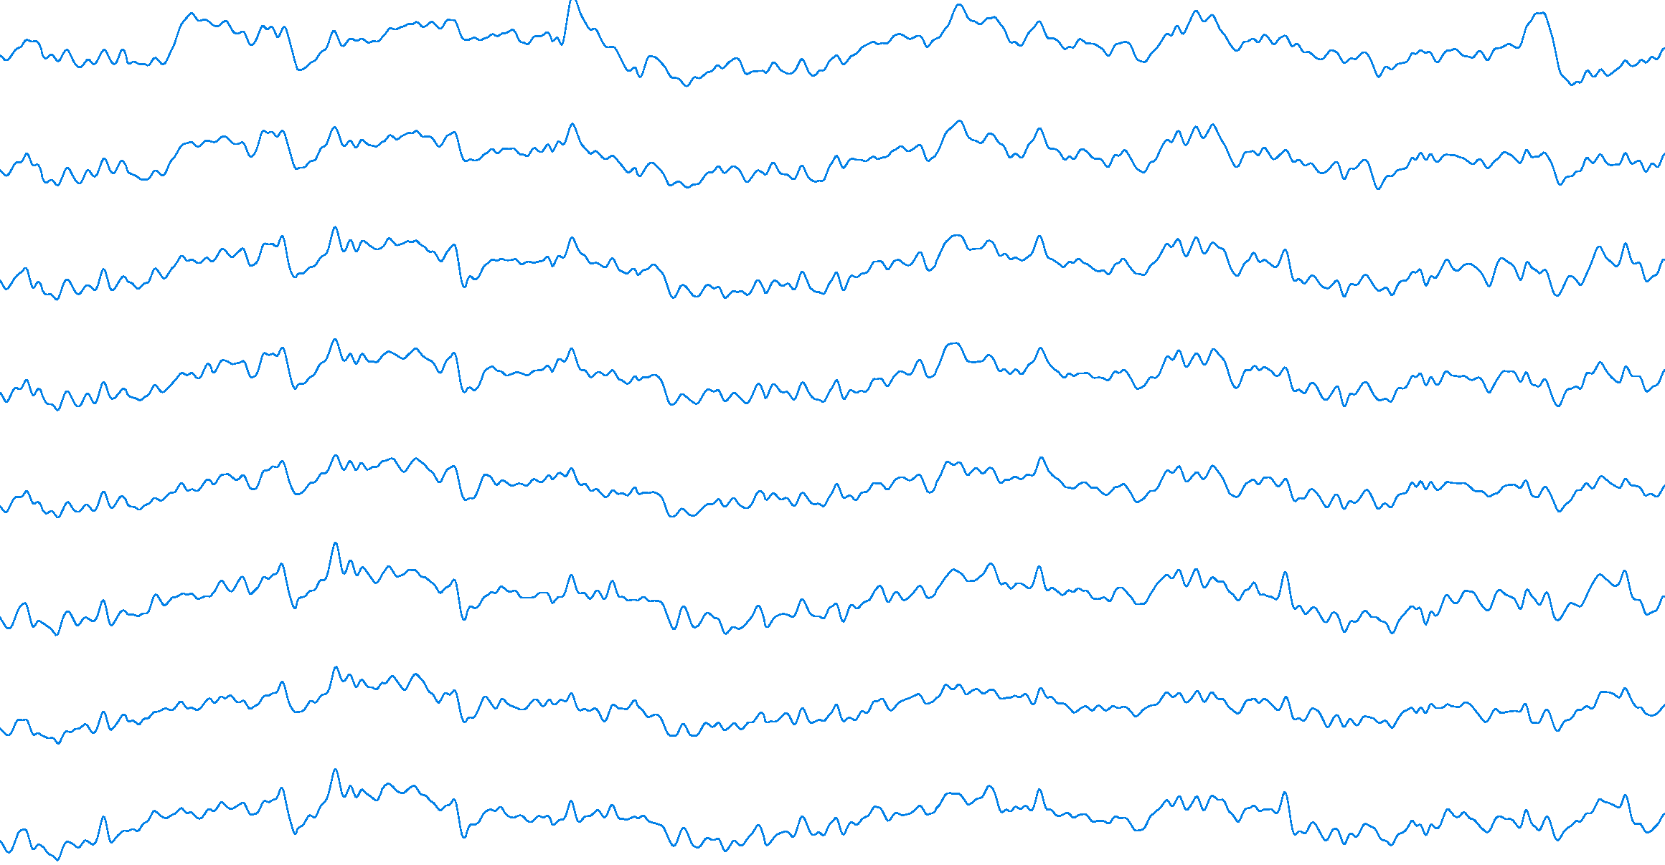



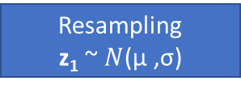
vEEGNet Encoder
μ
vEEGNet Decoder
Resampling
z₁ ~ $N$(μ ,σ)
σ
Concatenation
z₂ = [ μ , σ ]
Classifier
(FFNN)

Slide 3
Horizontal
Convolution
Vertical
Convolution
Depthwise
Convolution
Pointwise
Convolution
Flatten
Pointwise
Deconvolution
Depthwise
Deconvolution
Vertical
Deconvolution
Horizontal
Deconvolution
Reshaping

Slide 4
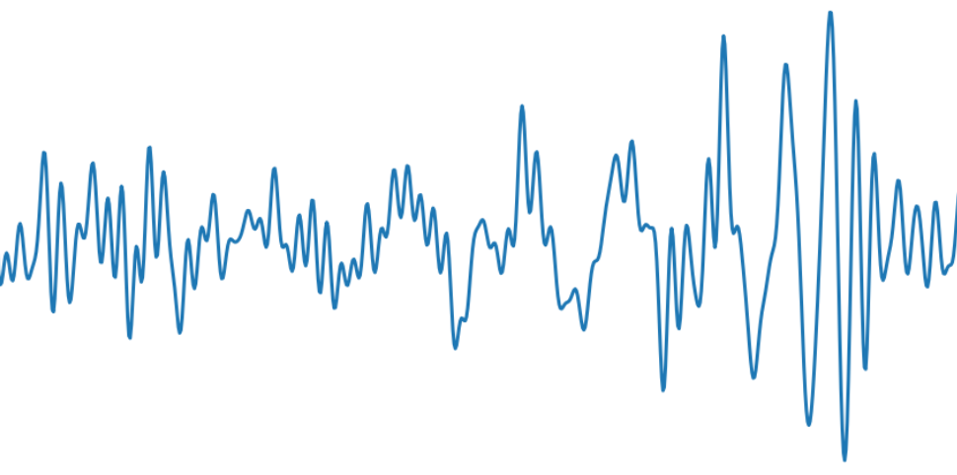
8 x 22 x 512
16 x 1 x 128
16 x 1 x 16
256
1 x 22 x 512
128
.
.
.
.
.
.
.
.
.
.
.
Temporal Convolution
Conv2d (1 x 64)
BatchNorm2d
Spatial Convolution
Depthwise Conv2d (22 x 1)
BatchNorm2d
Activation (SELU)
AvgPool2d (1 x 4)
Dropout (p = 0.5)
Separable Convolution
Depthwise Conv2d (1 x 32)
Conv2d (1 x 1)
BatchNorm2d
Activation (SELU)
AvgPool2d (1 x 8)
Dropout (p = 0.5)
Flatten
Fully connected
Linear (256 x 128)

Slide 5
16 x 1 x 16
16 x 1 x 128
8 x 22 x 512
256
64
1 x 22 x 512
.
.
.
.
.
.
.
.
.
.
.
Fully connected
Linear (64 x 256)
Reshape
Separable Transpose Convolution
Dropout (p = 0.5)
Upsample (1 x 128)
Activation (SELU)
BatchNorm2d
ConvTranspose2d (1 x 1)
Depthwise ConvTranspose2d (1 x 32)
Spatial Transpose Convolution
Dropout (p = 0.5)
Upsample(1 x 512)
Activation (SELU)
BatchNorm2d
Depthwise ConvTranspose2d (22 x 1)
Temporal Transpose Convolution
BatchNorm2d
ConvTranspose2d (1 x 64)

Slide 6
.
.
.

Slide 7
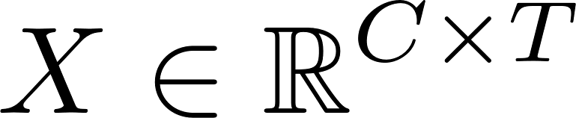
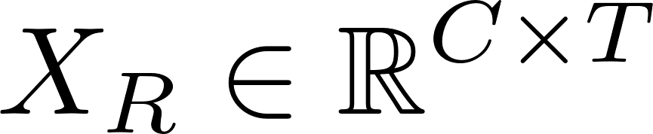
Te
Sp
SC
Z₃
+
Z₂
+
Z₁
Te
Sp
SC
+
+

Slide 8
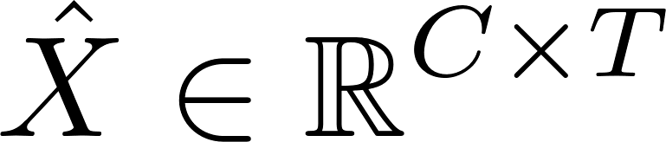
Te
Sp
SC
Z₁
Te
Sp
SC

